Slide 1
analysis of Time series models (review paper)
SOFTWARE GROUP PROJECT
7th-IT
Ishan Pansuriya - IU1841220028
Ketul Patel - IU1841220032 Smit Borasaniya - IU1841220053

Slide 2
Introduction to Time Series
A time series is a set of observation taken at specified times, usually at equal intervals.
A time series may be defined as a collection of reading belonging to different time periods of some economic or composite variables.
One variable is “Time” which is independent variable & and the second is “Data” which is the dependent variable.

Slide 3
Forecasting methods and models
Forecasting is the system of gathering predictions for the future based totally on historical and present information and the study of trends.
Forecasting uses an extrapolative method(s), where the forecasts for a series are only the function of time and past values of the series, not of any other additional variables.
Prediction is a comparable, however extra accepted time period.

Slide 4
List of Time Series Analysis methods:
ANN – Artificial Neural Network
RNN – Recurrent Neural Network
LSTM – Long-Short Term Memory
SVM – Support Vector Machine
ARIMA – Auto Regressive Integrated Moving Average Model

Slide 5
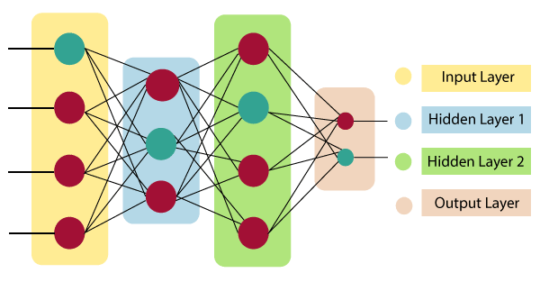

ANN – Artificial Neural Network
An ANN is based on a collection of connected units or nodes called artificial neurons, which loosely model the neurons in a biological brain.
Each connection, like the synapses in a biological brain, can transmit a signal to other neurons.
An artificial neuron receives a signal then processes it and can signal neurons connected to it.

Slide 6
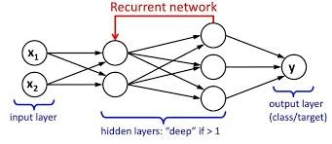
RNN – Recurrent Neural Network
A recurrent neural network (RNN) is a class of artificial neural networks where connections between nodes form a directed graph along a temporal sequence.
This makes them applicable to tasks such as unsegmented, connected handwriting recognition or speech recognition.
The term “recurrent neural network” is used indiscriminately to refer to two broad classes of networks with a similar general structure, where one is finite impulse and the other is infinite impulse.

Slide 7
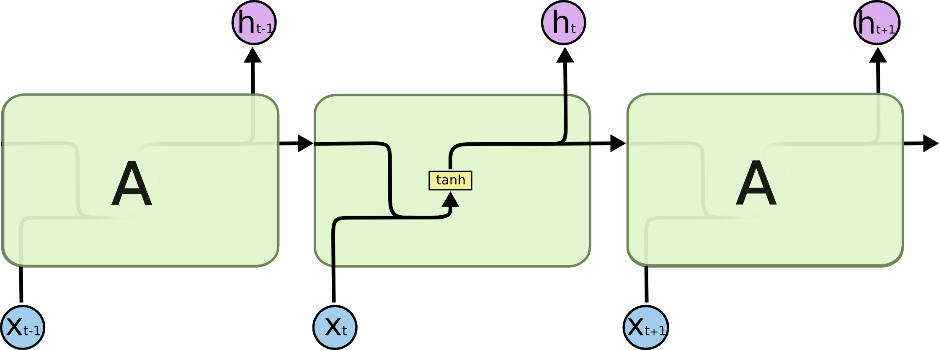
LSTM – Long-Short Term Memory
“LSTMs” – are a special kind of RNN, capable of learning long-term dependencies.
LSTMs are explicitly designed to avoid the long-term dependency problem.
All recurrent neural networks have the form of a chain of repeating modules of neural network. In standard RNNs, this repeating module will have a very simple structure, such as a single tan h layer.

Slide 8

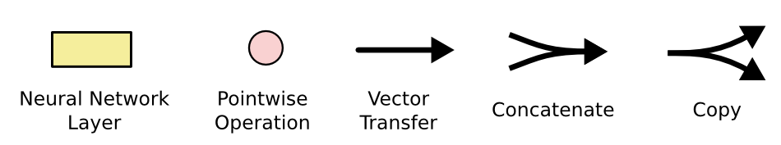
LSTMs also have this chain like structure, but the repeating module has a different structure. Instead of having a single neural network layer, there are four, interacting in a very special way.
In the above diagram, each line carries an entire vector, from the output of one node to the inputs of others.

Slide 9
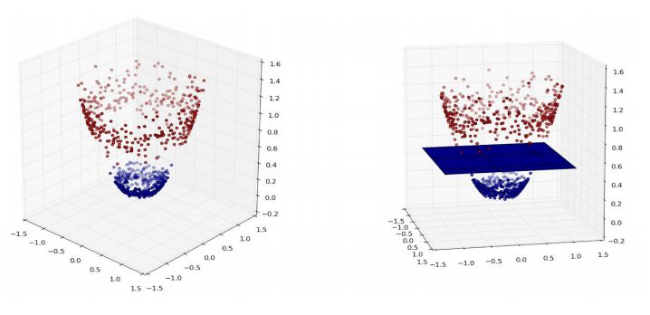
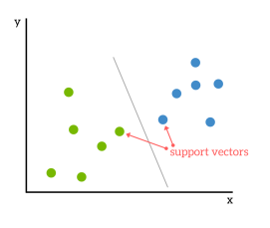
SVM – Support Vector Machine
SVM or Support Vector Machine is a linear model for classification and regression problems and outliers detection.
The idea of SVM is simple: The algorithm creates a line or a hyperplane which separates the data into classes.

Slide 10
WHAT ARIMA STANDS FOR?
ARIMA is an acronym that stands for Autoregressive Integrated Moving Average.
AR: Autoregression - A model that uses the dependent relationship between an observation and some number of lagged observations.
I: Integrated - The use of differencing of raw observations (e.g., subtracting an observation from an observation at the previous time step) in order to make the time series stationary.
MA: Moving Average - A model that uses the dependency between an observation and a residual error from a moving average model applied to lagged observations.

Slide 11
PARAMETERS OF ARIMA
The parameters of the ARIMA model are defined as follows:
p: The number of lag observations included in the model, also called the lag order.
d: The number of times that the raw observations are differenced, also called the degree of differencing.
q: The size of the moving average window, also called the order of moving average.

Slide 12
STEPS FOR ARIMA IMPLEMENTATION
The general steps to implement an ARIMA model are –
Load the data: The first step for model building is of course to load the dataset.
Pre-processing: Depending on the dataset, the steps of pre-processing will be defined. This will include creating timestamps, converting the type of date/time column, making the series univariate, etc.
Make series stationary: In order to satisfy the assumption, it is necessary to make the series stationary. This would include checking the stationarity of the series and performing required transformations, i.e., bringing the p-value < 0.5.
Determine d-value: For making the series stationary, the number of times the difference operation was performed will be taken as the d value.

Slide 13
Determine the p and q values: Read the values of p and q from the plots in the previous step.
Fit ARIMA model: Using the processed data and parameter values we calculated from the previous steps, fit the ARIMA model.
Predict values on validation set: Predict the future values.
Calculate RMSE: To check the performance of the model, check the RMSE value using the predictions and actual values on the validation set

Slide 14
References
Time-Series Forecasting: Predicting Stock Prices Using An ARIMA model Serafeim Loukas Jul 23, 2020
A SURVEY ON ARIMA FORECASTING USING TIME SERIES MODEL Z. Asha Farhath1 , B. Arputhamary 2 , Dr. L. Arockiam3 IJCSMC, Vol. 5, Issue. 8, August 2016, pg.104 – 109
Time-Series Forecasting: Predicting Stock Prices Using An LSTM Model Serafeim Loukas Jul 10, 2020
Financial time series forecasting using support vector machines September 2003 Neurocomputing 55(1-2):307-319
Financial time series forecasting using support vector machines Kyoung-jae Kim∗ Department of Information Systems, College of Business Administration, Dongguk University, 3-26, Pil-dong, Chung-gu, Seoul 100715, South Korea Received 28 February 2002; accepted 13 March2003
Predicting Stock Price Direction using Support Vector Machines Saahil Madge Advisor: Professor Swati Bhatt
How Does Support Vector Machine (SVM) Algorithm Works In Machine Learning?: https://www.analyticssteps.com/blogs/how-does-support-vector-machine-algorithm-works-machine-learning

Slide 15
Continued…
Selvamuthu, D., Kumar, V. & Mishra, A. Indian stock market prediction using artificial neural networks on tick data. Financ Innov 5, 16 (2019). https://doi.org/10.1186/s40854-019-0131-7
Time series forecasting using artificial neural networks methodologies: A systematic review Future Computing and Informatics Journal, Volume 3, Issue 2, 2018, ISSN 2314-7288, https://doi.org/10.1016/j.fcij.2018.10.003. (https://www.sciencedirect.com/science/article/pii/S2314728817300715)
Ina Khandelwal, Ratnadip Adhikari, Ghanshyam Verma, Time Series Forecasting Using Hybrid ARIMA and ANN Models Based on DWT Decomposition, Procedia Computer Science, Volume 48, 2015, Pages 173-179, ISSN 1877-0509, https://doi.org/10.1016/j.procs.2015.04.167. (https://www.sciencedirect.com/science/article/pii/S1877050915006766)
Tealab, Ahmed & Hefny, Hesham & Badr, Amr. (2017). Forecasting of nonlinear time series using ANN. Future Computing and Informatics Journal. 2. 10.1016/j.fcij.2017.05.001.
Pramod, & Pm, Mallikarjuna. (2021). Stock Price Prediction Using LSTM. Test Engineering and Management. 83. 5246-5251.
Time-Series Forecasting: Predicting Stock Prices Using An LSTM Model Serafeim Loukas Jul 10, 2020 https://towardsdatascience.com/lstm-time-series-forecasting-predicting-stock-prices-using-an-lstm-model-6223e9644a2f

Slide 16
Thank you

